Slide 1

Building an Influential Future: The Power of Company's Influencer Board
A Quantitative Analysis of Board Type in US-Based Companies
ALY 6980: Capstone Project Presentation
Group 7:
Vaidehi Patole
Chaitang Priyang shah
Bhanoji Meka

Slide 2
Executive Summary
Directors' Impact on Firm Performance
Governance and Oversight
Strategic Decision Making
Executive Leadership and Accountability
Financial Performance and Investor Confidence
Risk Management and Crisis Response
Stakeholder Relations
Board Diversity and Inclusion

Slide 3
Approach
Analytical Study: Research Presumptions & Propositions unveiling the Research Parameters and Objectives
Data Manipulation: feature extraction, data cleansing, etc..,
Exploratory Analysis: unveil the correlations between board type and attributes of directors' performance
Predictive Models: assess the performance of classification models and derive robust statistical findings
Actionable Insights: Valuable and practical findings derived from analyzing data that can be used to drive specific actions to achieve desired outcomes

Slide 4
Research presumptions
Impact on Board type
Identities
Historical/Present CEO
Insider?
Smart People
Network power
Connect with each other
Influence
Highest percentage influence
Committee
Gender Power gap
Performance
Company League and Directors
Category
EBITDA Win rate
TSR Win rate
Carbon Win rate
Controversy win rate
Research Presumption: To identify the influence characteristics of director's Identities, performance on the board type is examined.
We believe that these are the attributes that will have an impact on the board type of a company.

Slide 5
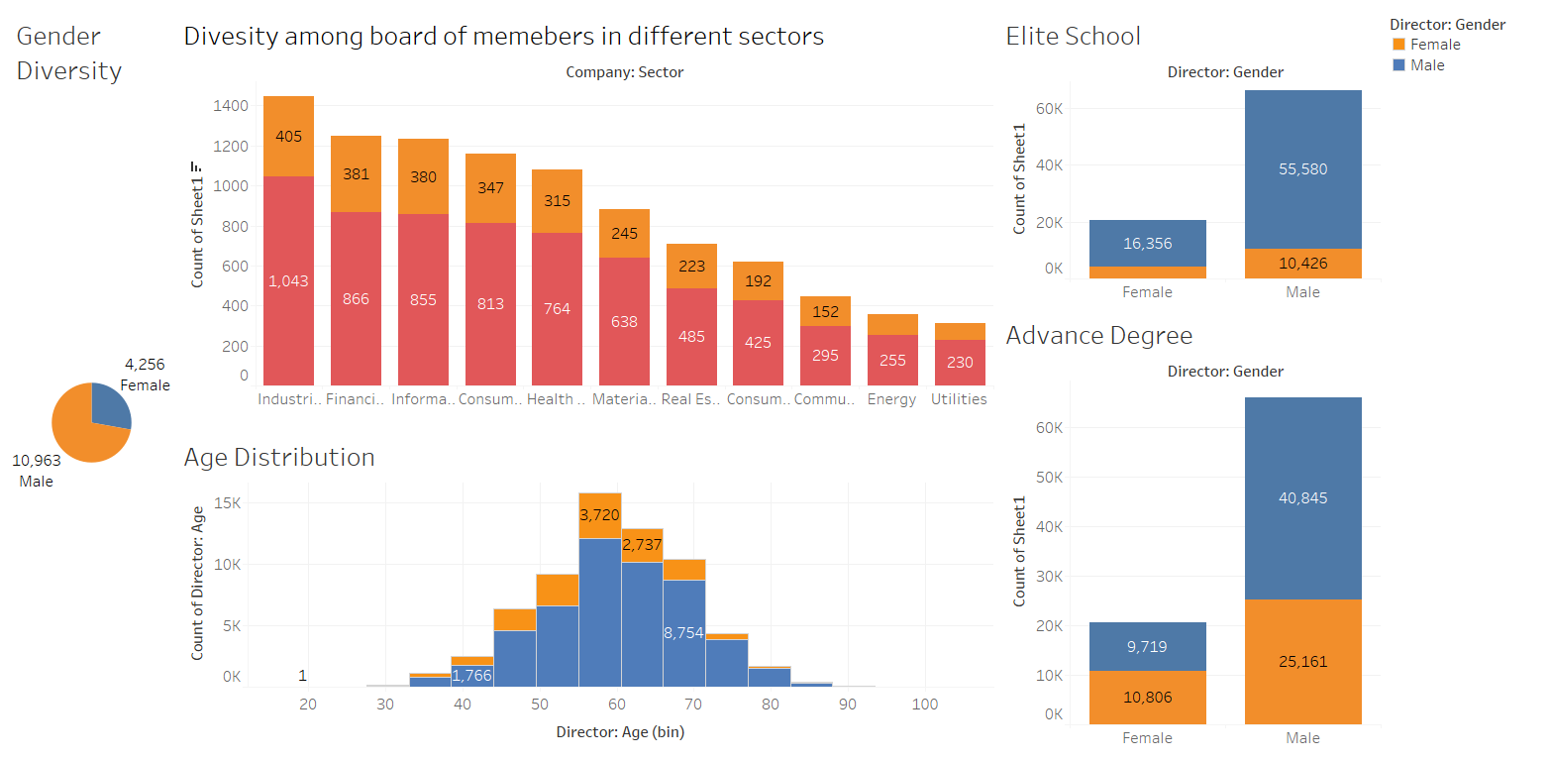
Exploratory Data Analysis

Slide 6
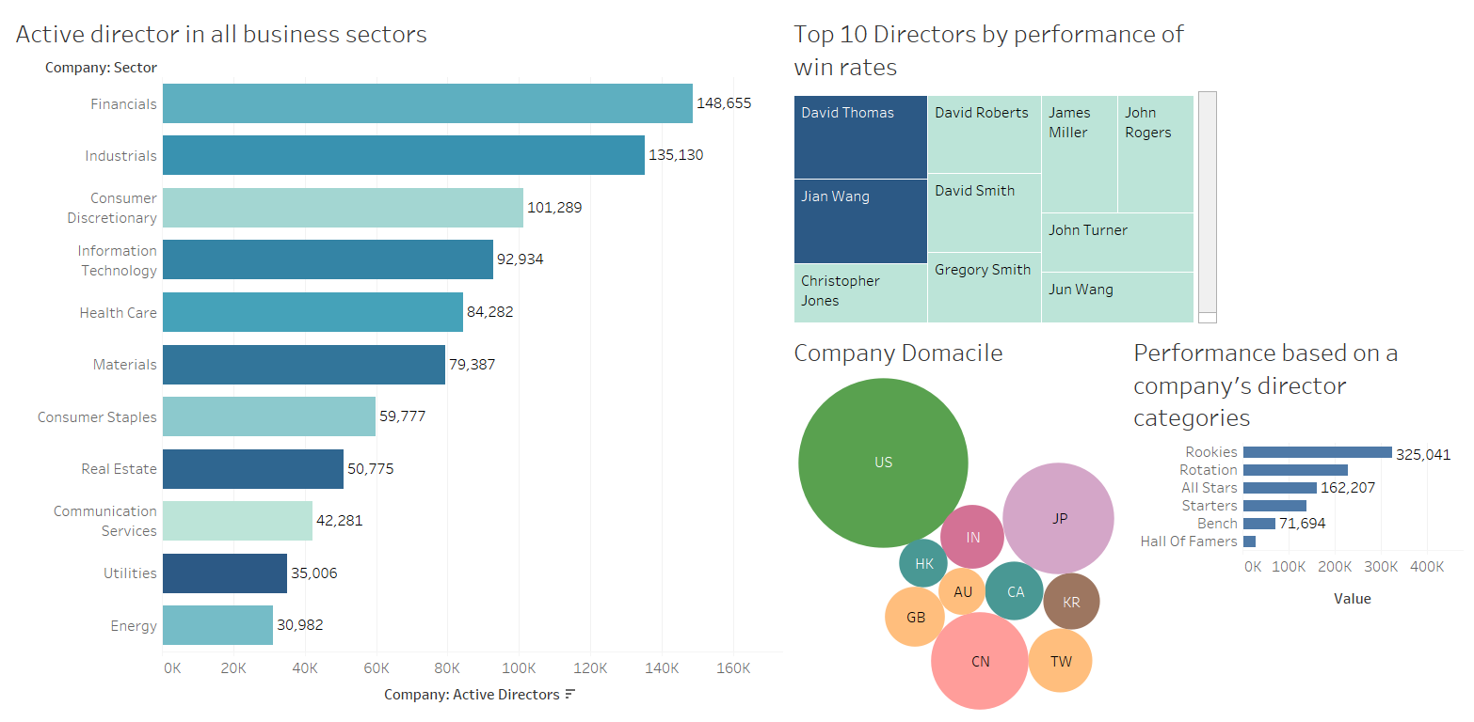

Slide 7
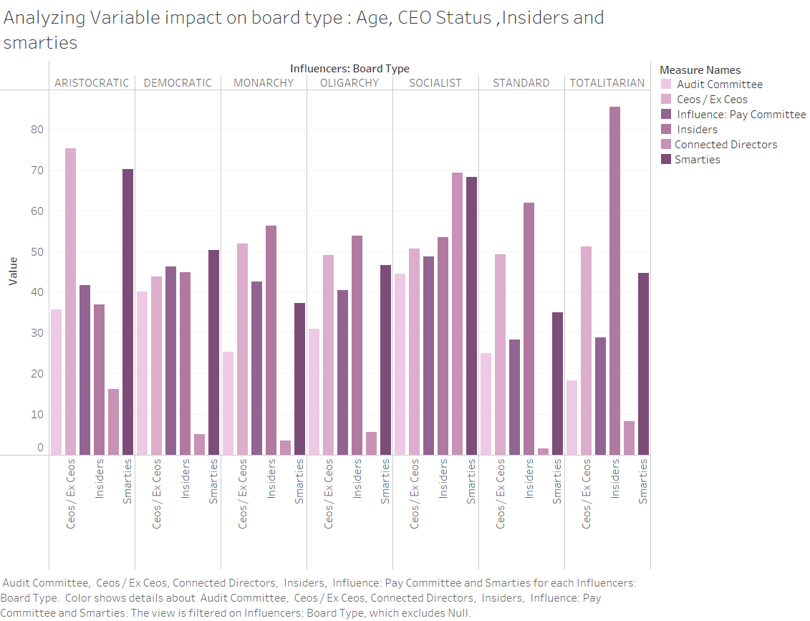
Variable Impact on Board type
The chief executive officer, individuals possessing astute intellect, possess an advantage in setting benchmarks, authoritative, collectivist control panels.
Meanwhile, all functionalities present comparable and moderate effects on governance systems encompassing democracy, monarchy, and oligarchy.

Slide 8
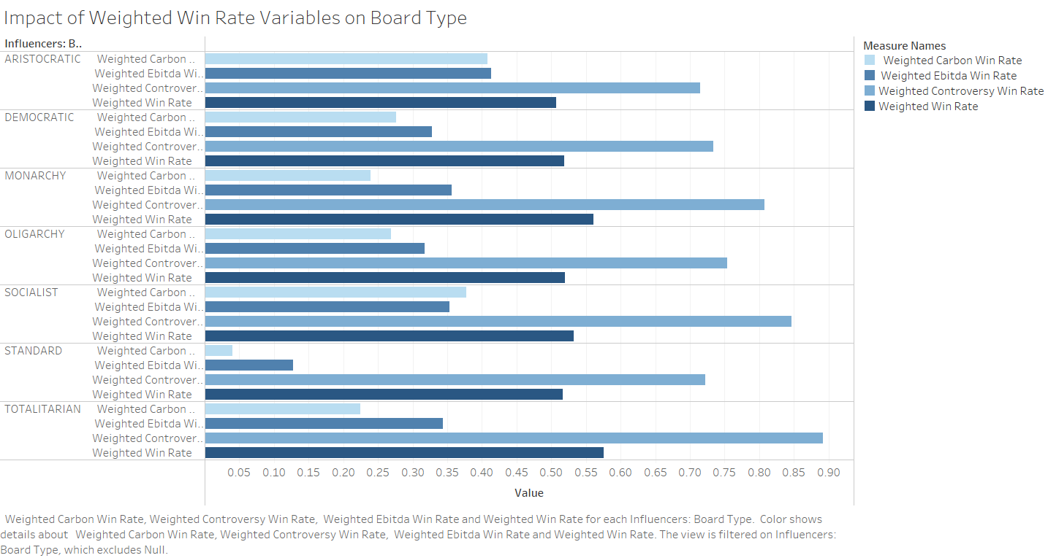
Weighted Win rate variables impact
The influence of weighted controversy win rate and weighted win rate is substantial across all types of boards. Conversely, the influence of carbon weighted win rate and EBITDA win rate is comparatively diminished within each category of board type.

Slide 9
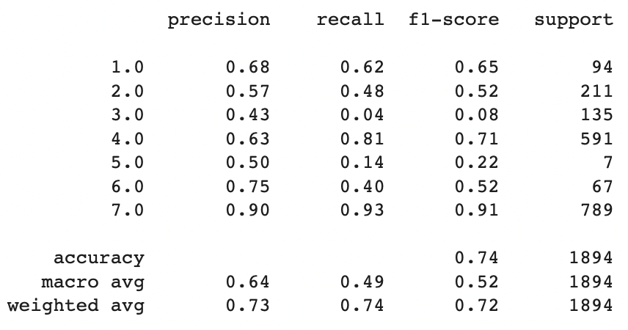
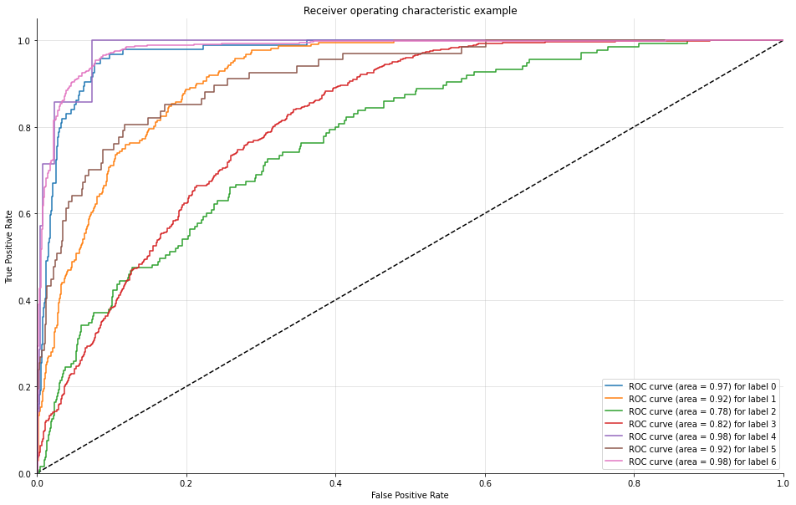
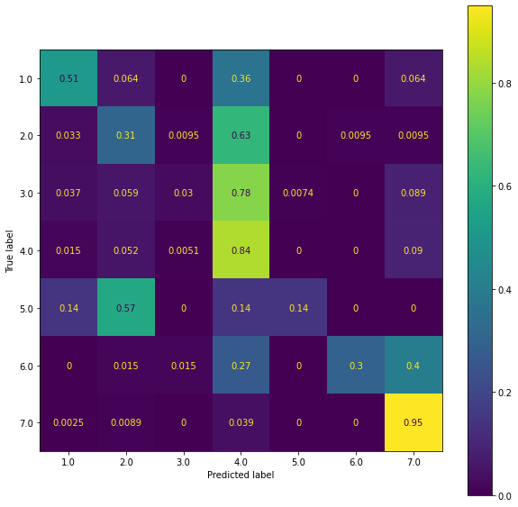
1 | ARISTOCRATIC
2 | DEMOCRATIC
3 | MONARCHY
4 | OLIGARCHY
5 | SOCIALIST
6 | STANDARD
7 | TOTALITARIAN
Performance Matrix
Logistic Regression Model
74 % accuracy and 64 % Average Precision

Slide 10
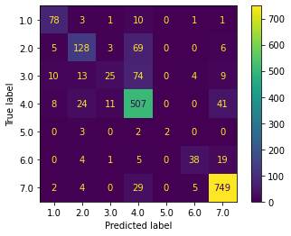
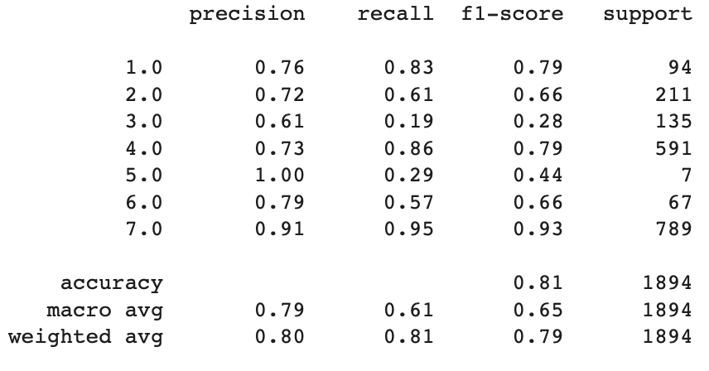
Random Forest Model
81% Accuracy on predicting Board type
80% Average Precision on Predicting Board type
1 | ARISTOCRATIC
2 | DEMOCRATIC
3 | MONARCHY
4 | OLIGARCHY
5 | SOCIALIST
6 | STANDARD
7 | TOTALITARIAN

Slide 11
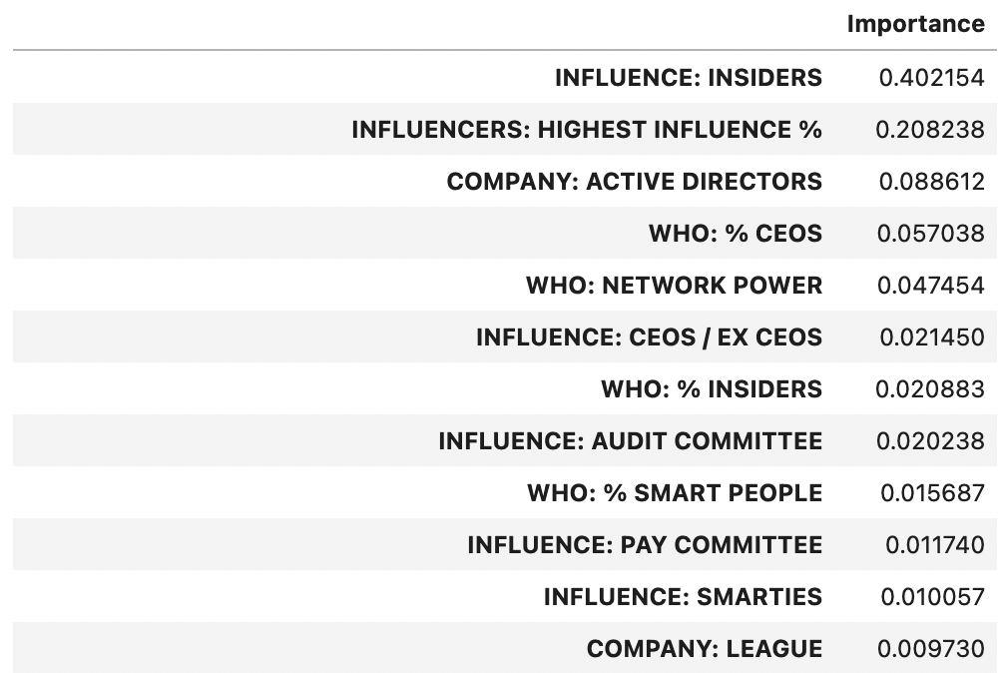
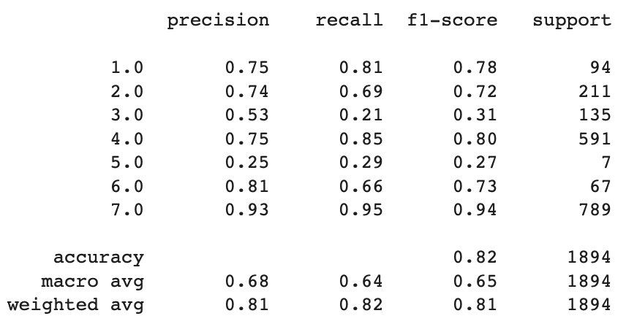
Gradient Boosting
Feature Importance
1 | ARISTOCRATIC
2 | DEMOCRATIC
3 | MONARCHY
4 | OLIGARCHY
5 | SOCIALIST
6 | STANDARD
7 | TOTALITARIAN
Performance Matrix
82% Accuracy on predicting Board type
81% Average Precision on Predicting Board type

Slide 12
Actionable Insights
As the CEO or Chairman of an organization, holding the highest influence yields substantial positive effects on the Board type. The likelihood of their Board type being determined is 2 to 4 times greater when considering insiders, influential individuals, intelligent individuals, and audit committees.
On the other hand, the performance category or win rates of former CEOs, Chairmen, or lead directors have notably adverse consequences on departure outcomes. The accuracy of predicting their Board types is less than 10% compared to other variables considered.
Furthermore, serving as a member of nominating, pay, or audit committees moderately affects the Board type categories. Their predictions align with the actual Board types less than 40% of the time, as opposed to other variable insights.

Slide 13

Actionable Insights
The application of Gradient Boosting, a classification method, demonstrated the highest accuracy in predicting the board type of companies based on multiple variables and the influence of data structures. To further improve the predictive model, the following aspects should be considered:
Addressing Imbalanced Distributions: Overcoming the imbalance in independent variables' distributions.
Variable Control: Controlling variables related to sectors, capital levels, and other relevant factors.
Combination of Processing Strategies: Exploring the combination of two different strategies for processing IPS (Independent Variable Set) in various structures.
Refining Assumptions and Target-Identifying Algorithm: Modifying assumptions and the algorithm used to identify the target, incorporating additional and more detailed data sources.

Slide 14
Bibliography
Eccles, R. G. (2021, June 2). The Board’s Role in Sustainability. Harvard Business Review. https://hbr.org/2020/09/the-boards-role-in-sustainability
SEC.gov | Climate, ESG, and the Board of Directors: “You Cannot Direct the Wind, But You Can Adjust Your Sails.” (2021, June 28). https://www.sec.gov/news/speech/lee-climate-esg-board-of-directors
Hakovirta, M., Denuwara, N., Bharathi, S., Topping, P., & Eloranta, J. (2020b). The importance of diversity on boards of directors’ effectiveness and its impact on innovativeness in the bioeconomy. Humanities & Social Sciences Communications. https://doi.org/10.1057/s41599-020-00605-9
Morkovich, E., Morkovich, E., & Morkovich, E. (2020). Project Sponsor: Definition, Role, Responsibilities, Examples. Your Guide to Project Management Best Practices. https://mymanagementguide.com/project-sponsor-indentifying-project-sponsor-role-and-responsibilities/#:~:text=Project%20sponsor%20administers%20project%20finances,and%20participates%20in%20stakeholder%20management

Slide 15
THANK YOU

